Slide 1
Reporting Via Power BI

Slide 2
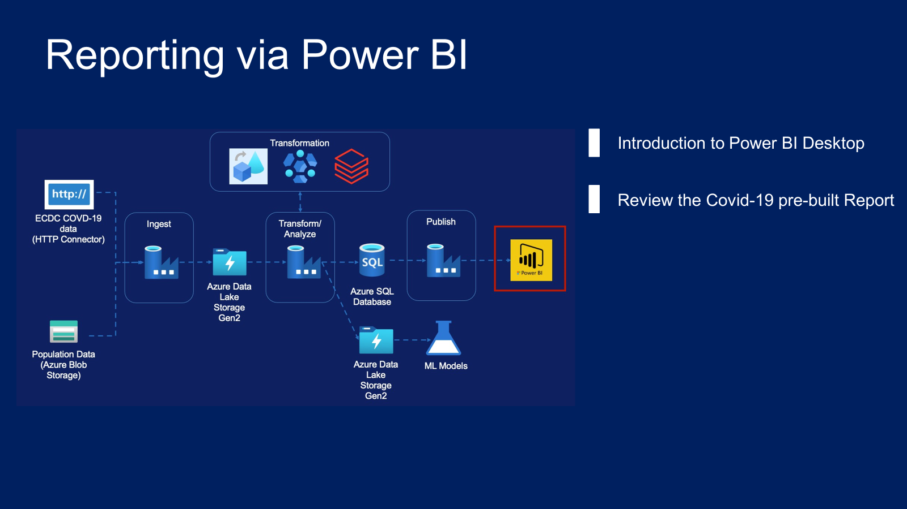

Slide 3
Power BI Desktop Overview

